Slide 1

Capstone Project
Patryk Niedźwiecki

Slide 2
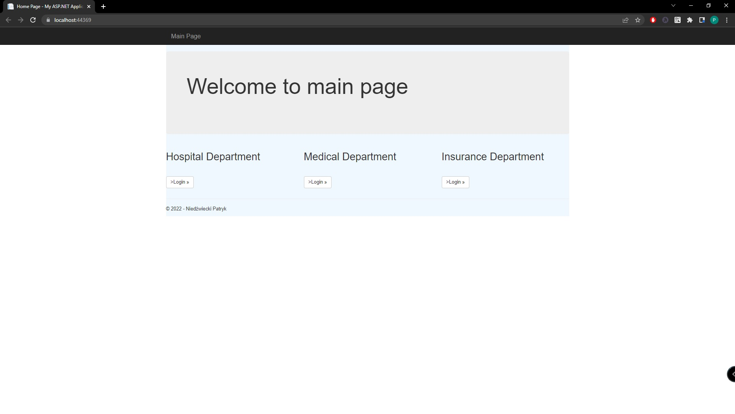
Main Page
When we are starting up our projects, we will be able to select into which department we want to log in

Slide 3
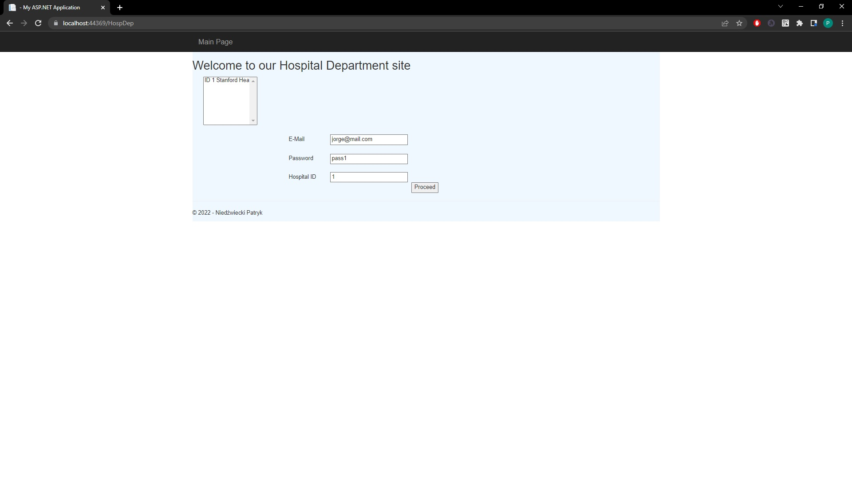
Hospital Department
We have to take a look at the list of the hospitals on the left, pass hospital’s id into correct textbox and log in by e-mail and password

Slide 4
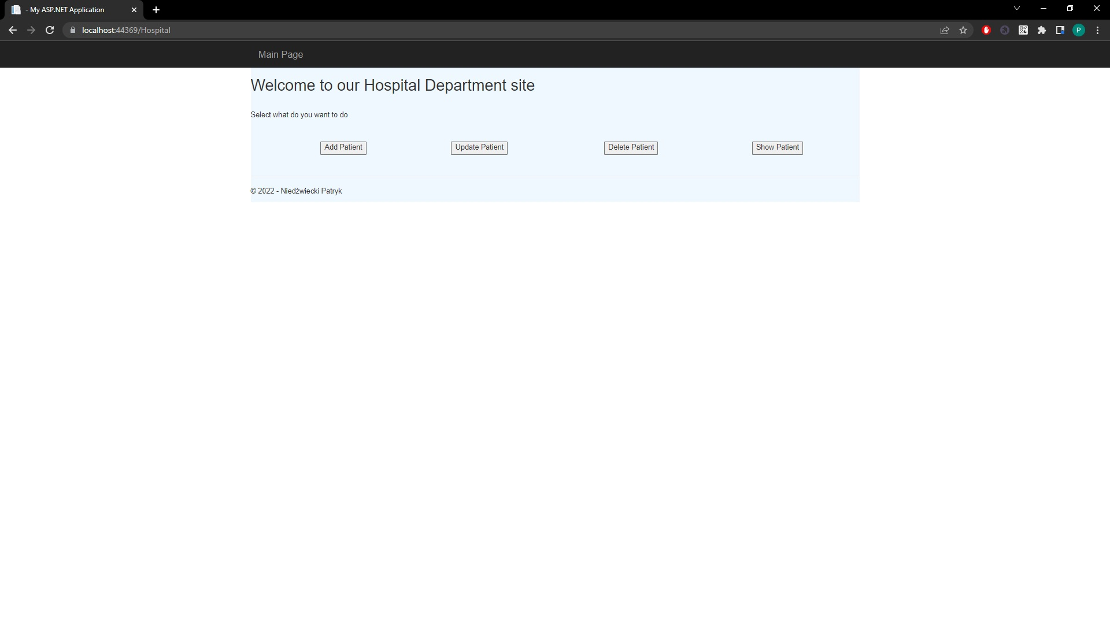
Hospital Department
After logging in we can select what do we want to do, by clicking buttons.

Slide 5
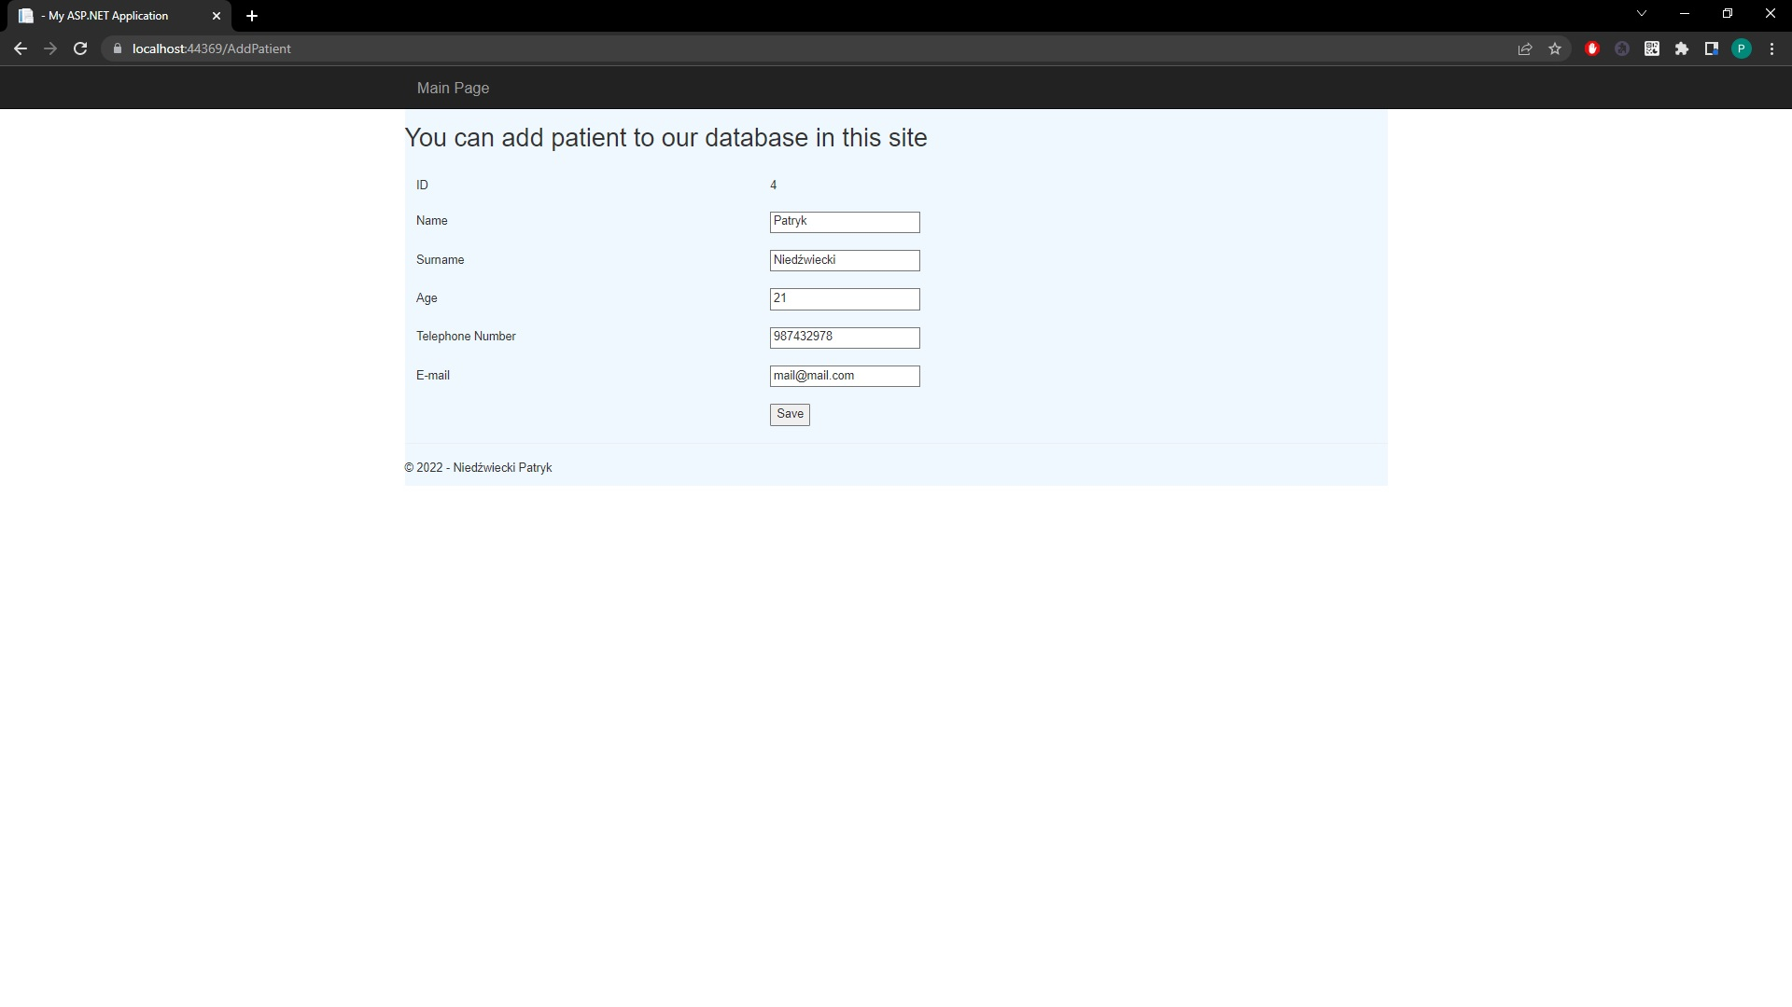
Hospital Department
If we want to add patient, we have to pass here details of our patient and then patient will be saved in our database.

Slide 6
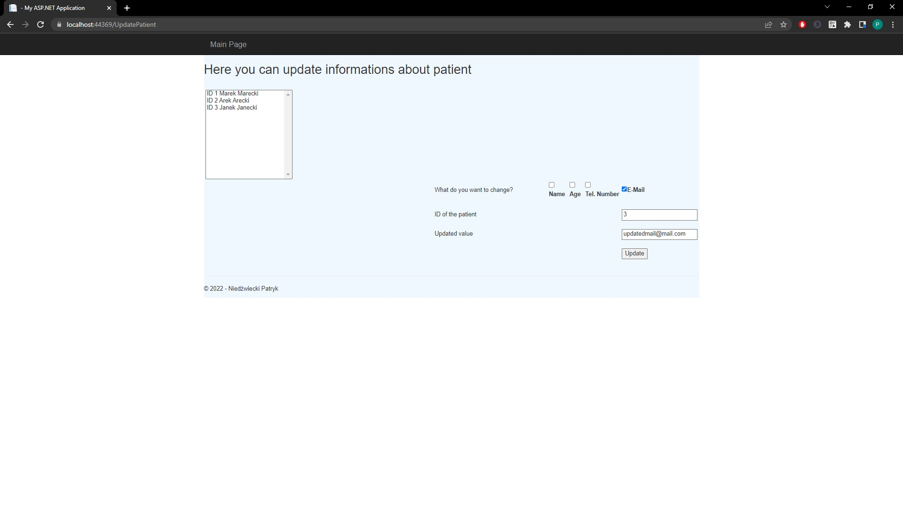
Hospital Department
If we want to update patient, we have to take a look at tchem on the list, then select what do we want to change, pass id of the patient and new value, then click Update buton to update his details in our database

Slide 7
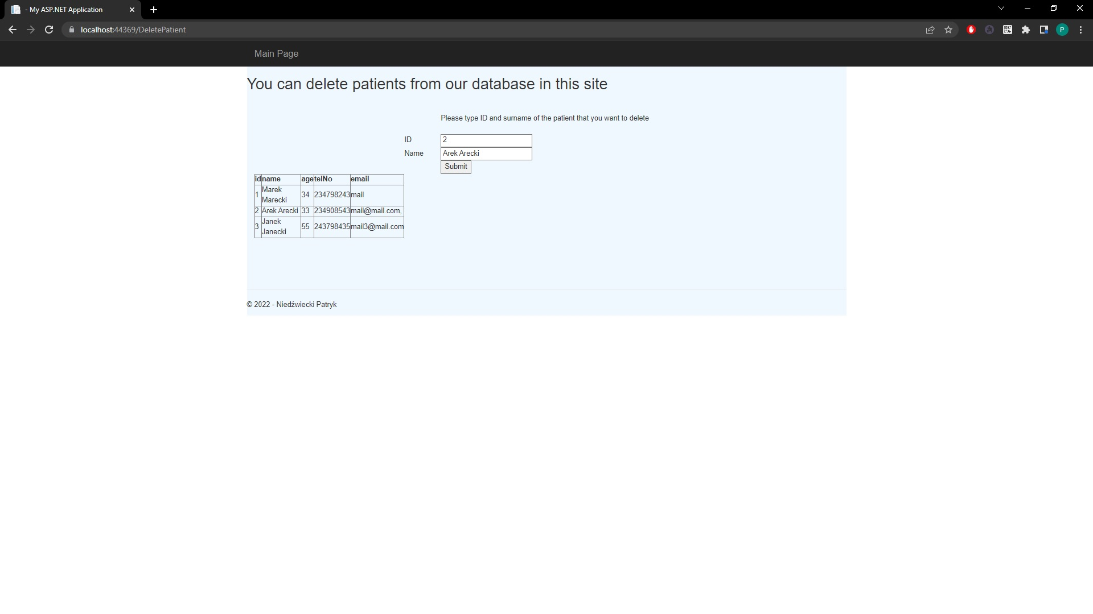
Hospital Department
If we want to delete patient, we have to choose one from the list, take a look at his ID and pass it in textbox. Name textbox is for confirmation that we really want to delete this patient, to avoid any problems.

Slide 8
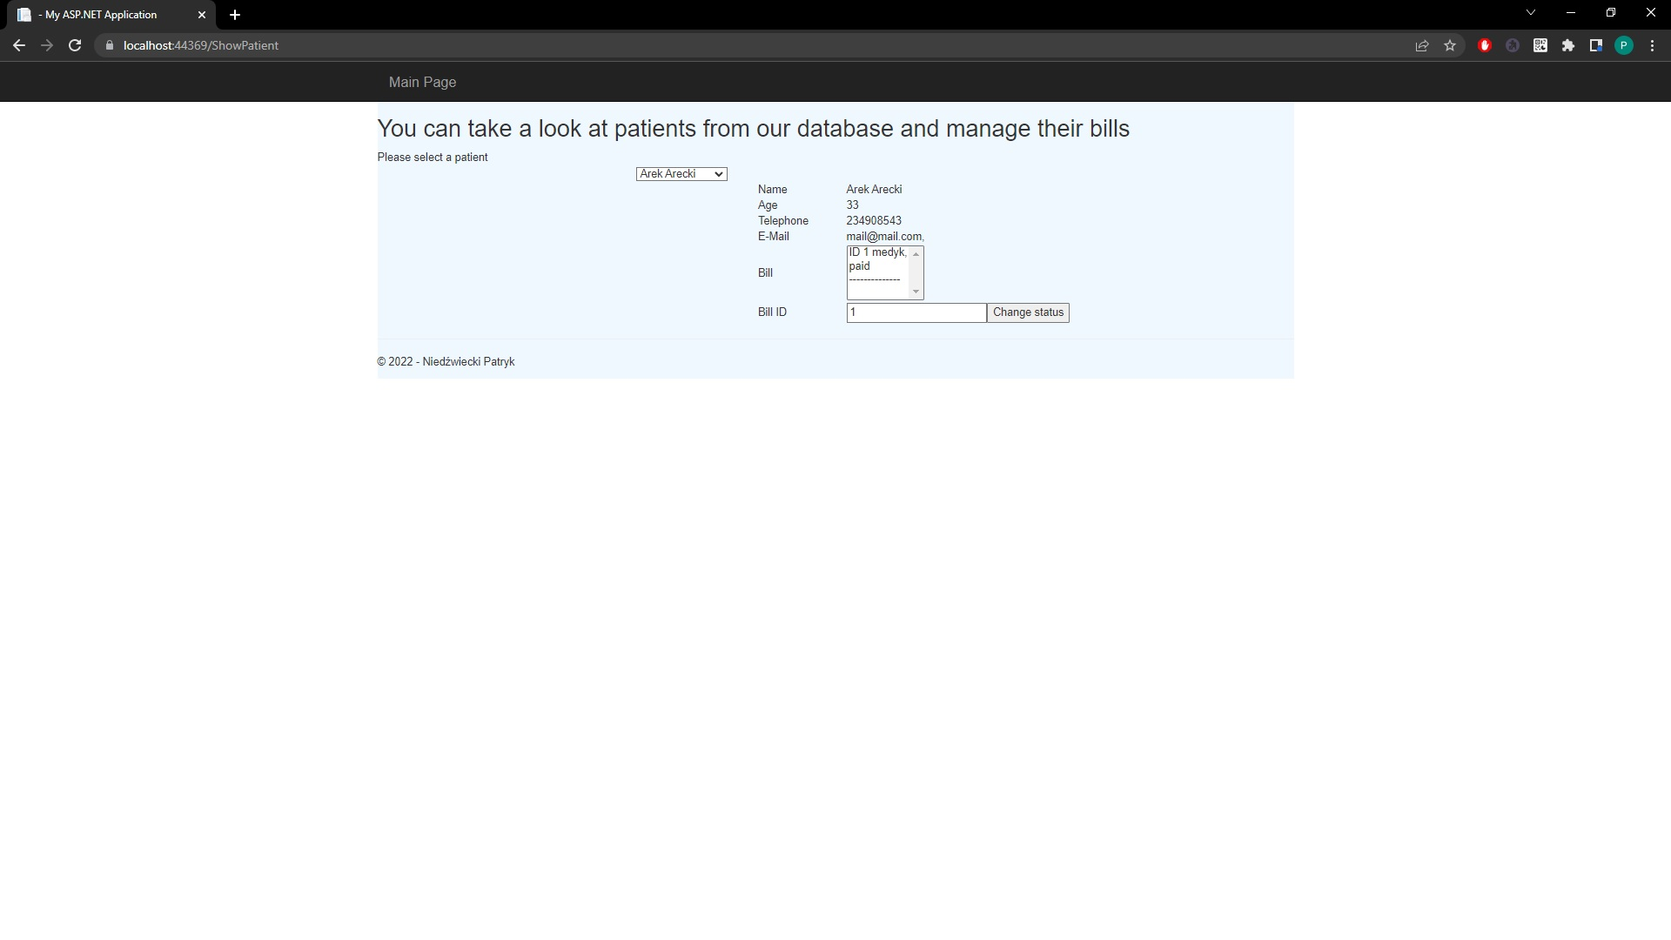
Hospital Department
If we want to take a look at patients, we have to select one of them, then we will be able to see his details, also if patient has any bills, we will be able to see them on the list and change status of the bill from not paid, to paid. As in the reception patient can pay for his bills.

Slide 9
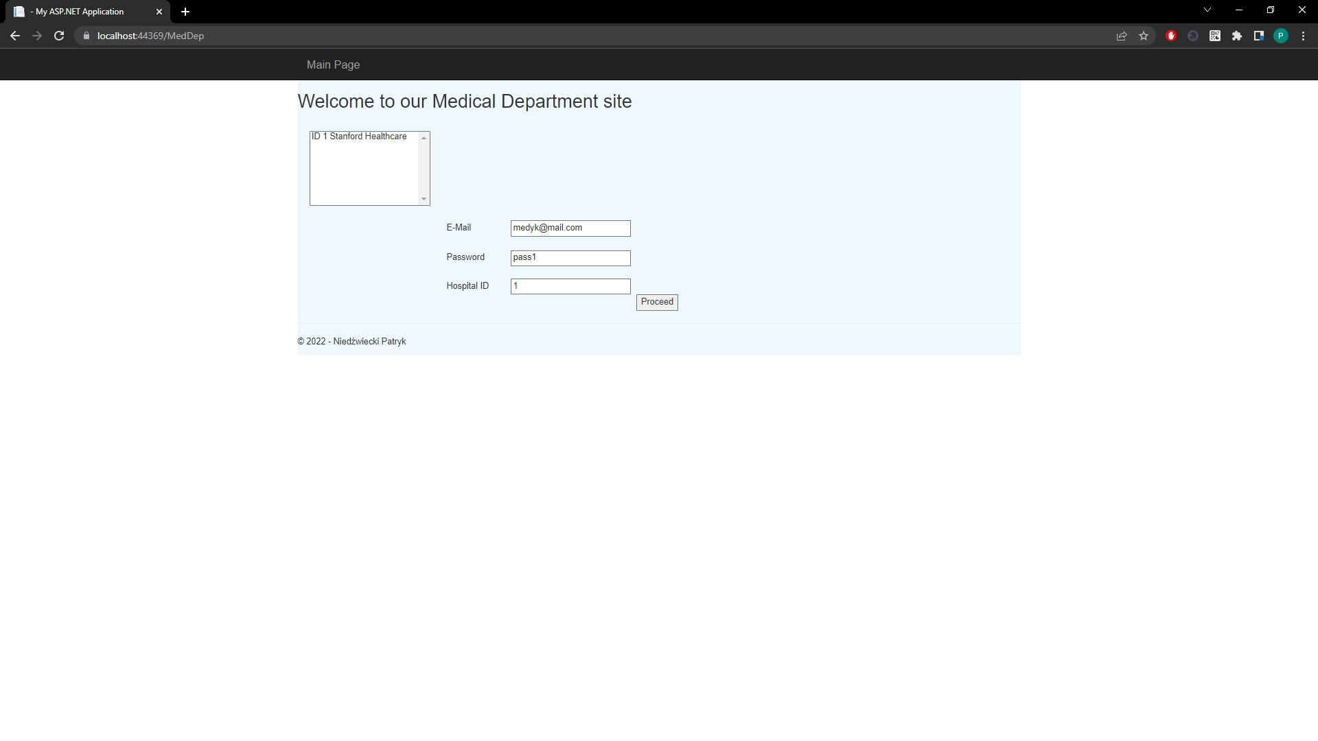
Medical Department
As in the hospital dept. we have to take a look at the list of the hospitals on the left, pass hospital’s id into correct textbox and log in by e-mail and password

Slide 10
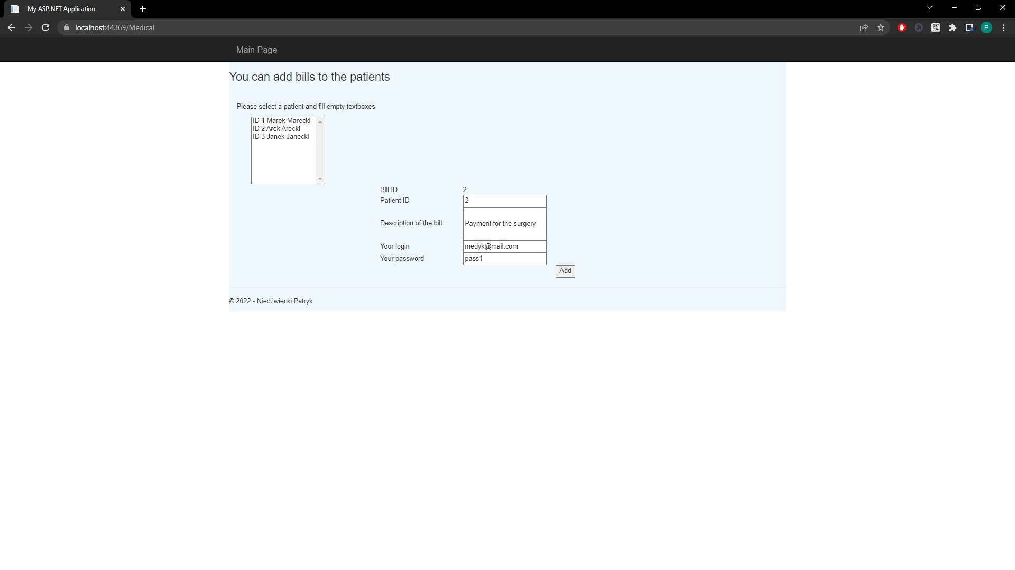
Medical Department
If our mail and password assigned to the hospital are correct we can add bills to the patient, by their id. To avoid any other people to give patient bill, as a confirmation we have to pass our e-mail and password once again.

Slide 11
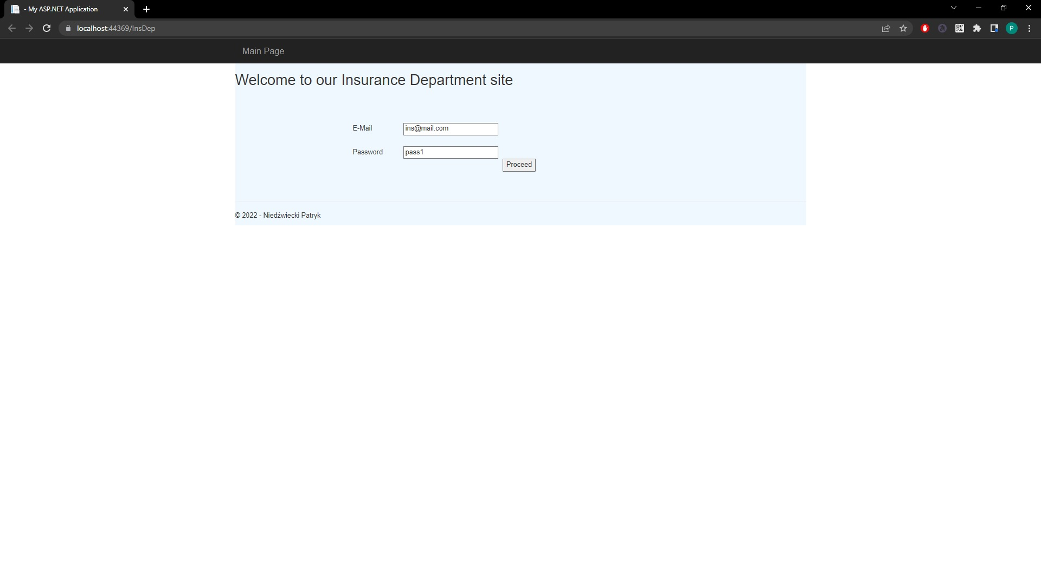
Insurance Department
This is our Insurance Department’s login site, here we are passing our e-mail and password

Slide 12
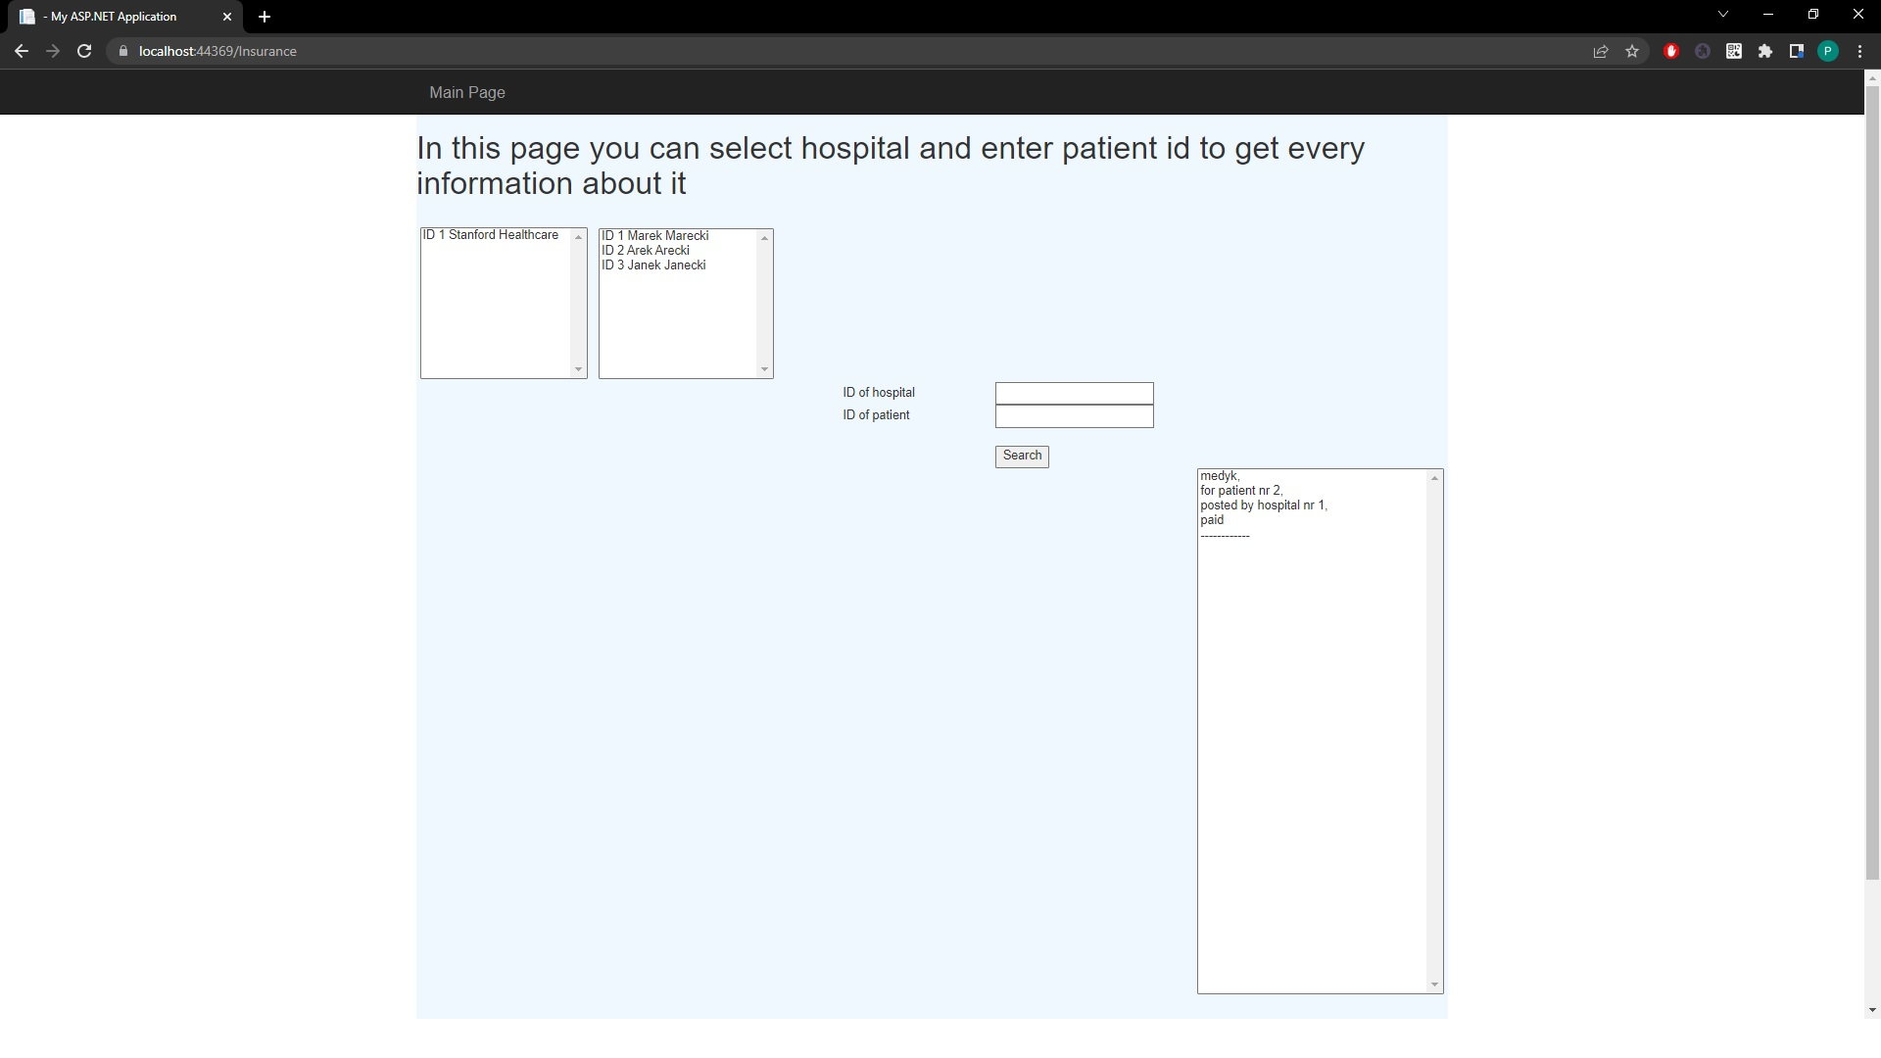

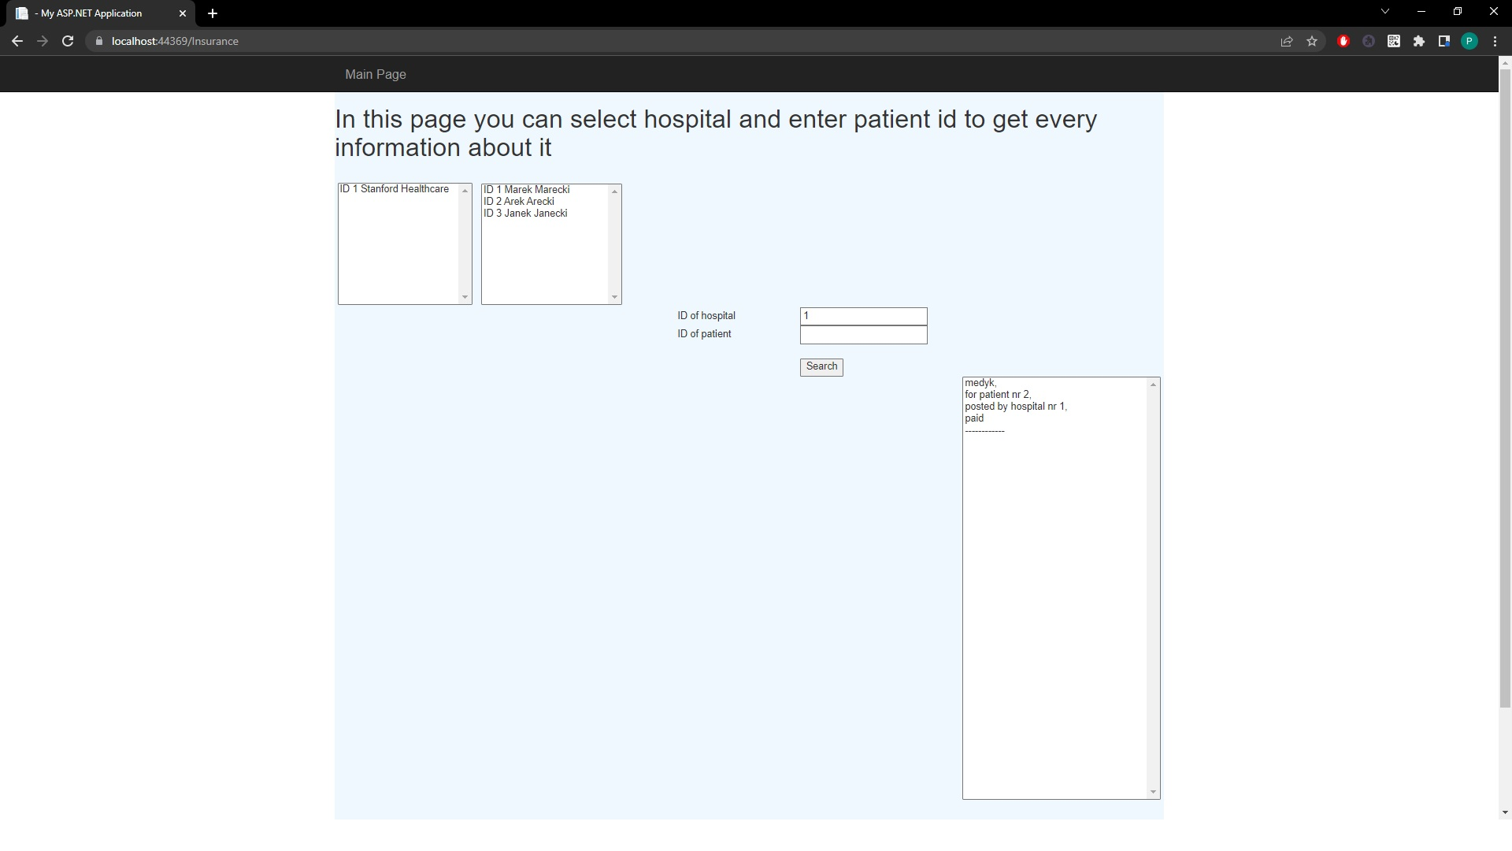

Insurance Department
Here we can take a look at the patient’s bills. We can take a look at every bill in the database, we can take a look at the bills of the hospital, of the patient and if we want, we can also take a look at the bills from one patient, and one hospital.

Slide 13
The end

